Slide 1
Machine Learning

Slide 2
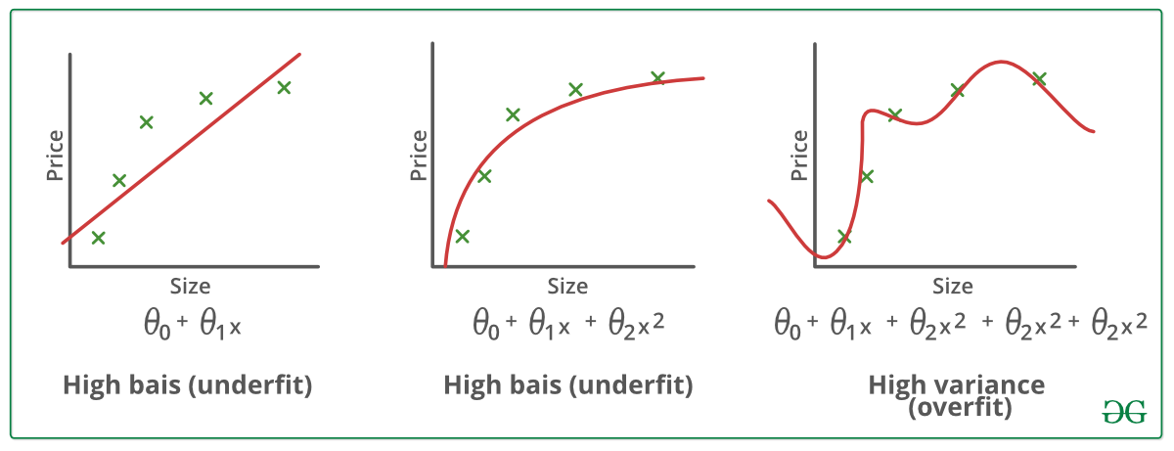
The Problem of over and under fitting

Slide 3
Over & under Fitting
When your data is complicated, mixed and has a lot of features and you are trying to fit the line with linear Equation its cause “Under fitting or called High Bias”.
When your data is simple and has a small number of features and you are trying to fit the line very will with complex non-linear equation or polynomial equation its cause “overfitting or called High Variance”.

Slide 4
OverFitting or called (high Variance)
It's just work only on your available data but does not generalize well to unseen data since you need your model to work in real life.
It's caused in case your features is bigger relative to small number of data.
Iit's also caused when you make a complicated Non-linear function.
It caused when you are trying to fitting you data very well and you try to fit each point of your data. its work worse in real life.

Slide 5
Underfitting or called (high Bias)
its caused when your our hypothesis function try to maps poorly the trend of the data.
It's caused in case your features is smaller relative to bigger number of data.
It's also caused when you make a simple linear equation to fit your data when its has a lot of features and training examples.
Its caused when you are trying to fixing your data with linear or simple equation.

Slide 6
Handle over & under fitting
When its comes to overfitting you can:
Reduce the number of features
Regularization
When its comes to underfitting you can:
Try with complex non-linear function
Try to add more features to your data
It's helpful to take look at these steps when you fill in one of these problems

Slide 7


Regularization
It's possible to change some of parameters to small number which will reduce the effect of the features associated with these parameter. S
Θ₀​+θ₁​x₁+θ₂​x₂+θ₃​x₃+θ₄​x₄
We can reduce the θ₃​ and θ₄ by multiply by 100 this will cause these parameters to change a bit and will cause the cost function to be bigger a bit, but its will be good for real life.
The effect is all about change the parameters like thetas, so we can instead of just theta 3 and 4 we do it for all thetas in on step, and instead of 1000 we choose labada as new hyper parameters.
One of the methods that help us handle the problem of overfitting over the data with different techniques.

Slide 8
Regularization Factor λ
Its help us reduce the overfitting problem as its multiply by thetas parameters which will cause these parameters to change a bit to be bigger or smaller wand to be less effect on the features that multiply by.
Now we can smooth the output of our hypothesis function to reduce overfitting. But choosing λ has different effect so once λ = 0 it will not change anything, but more bigger λ values can also cause in problem of underfitting (high bias).
Its from theta 1 because theta0 is multiply by x0 which =1, and has no effect in practice.
Cost function of Logistic Regression with Regularization:

Slide 9
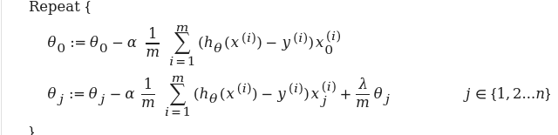
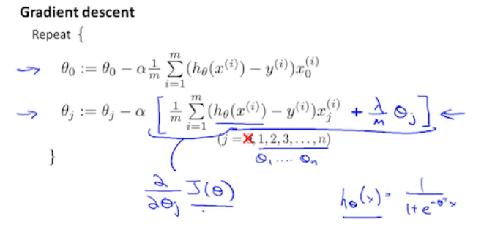
Apply Regularization to Linear & logistic Regression
Gradient Descent of Linear Regression with Regularization
Gradient Descent of Logistic Regression with Regularization

Slide 10
Logistic Regression with Unvirate & Multi Variables Example
Classification Example

Slide 11
Neural Networks
Is Coming.

